Slide 1
ClearCoin Attestation
Portal
CLEARCOIN FOUNDATION
CAP v1.0.0-rc.2
Stakeholder briefing
Trust, workflow and readiness
June 27, 2026

Slide 2
Attestations require trust that can be reviewed, repeated and defended.
The challenge
Evidence arrives through files, emails and manual handoffs. Stakeholders need one authoritative history.
The CAP response
A controlled workflow that binds reports to evidence, approvals, timestamps and audit records.

Slide 3
One platform, four accountable roles
Role-based access keeps preparation, approval and platform administration separated.
Guest
Auditor
Admin
Superadmin
Read-only orientation and transparency
Prepare reports and bind evidence
Review, approve and monitor
Full user and session control

Slide 4
The attestation journey
1. Prepare
Auditor gathers final source records and confirms the reporting period.
2. Upload
PDF evidence is stored and assigned a SHA-256 digital fingerprint.
3. Create
The auditor records values, dates, ratios and explanatory notes.
4. Attach
Uploaded evidence is explicitly connected to the correct report.
5. Review
Validation freezes evidence; management then approves or rejects.
6. Submit
Approved work enters the broadcast-pending queue for future relayer processing.

Slide 5
Trust is designed into the workflow
File fingerprint
Every PDF receives a SHA-256 hash so later changes can be detected.
Frozen evidence
Validation locks the reviewed evidence package before approval.
Accountable history
Key actions record the actor, resource, reason and platform time.

Slide 6
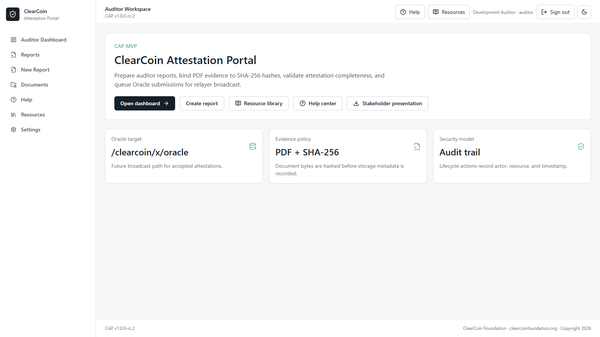
A clear entry point
for every role
Public orientation, role-aware sign-in, Help and Resources.

Slide 7
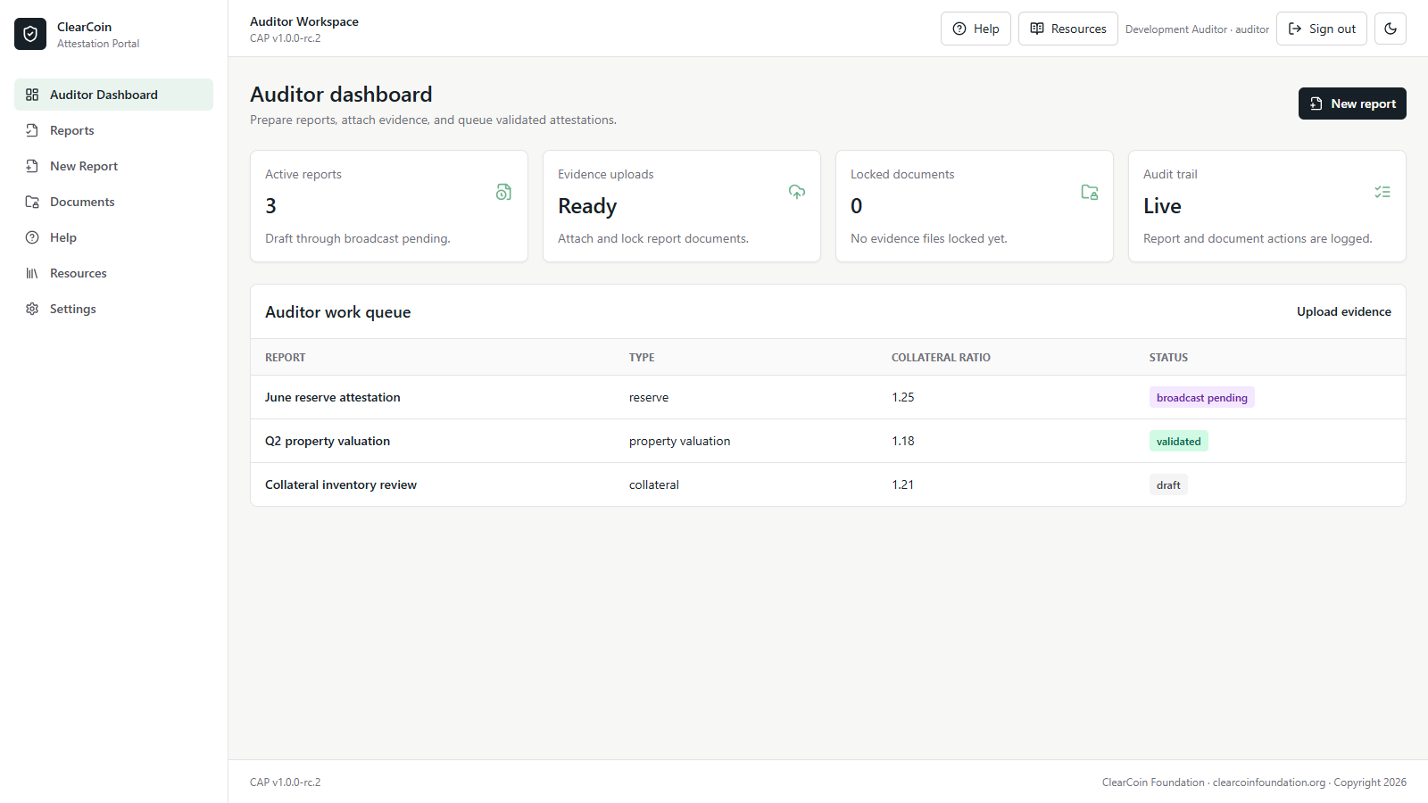
Auditors work from
one focused queue
Reports, evidence status and next actions remain visible.

Slide 8
A modular platform behind a simple experience
Experience layer
Web portal, role dashboards, Help Center and Resource library.
Application services
Authentication, reports, evidence, approvals, audit and platform time.
Trusted infrastructure
PostgreSQL, MinIO, Redis, Caddy and the dry-run relayer.

Slide 9
Controls protect identity, evidence and accountability
Identity and access
Each person works through an assigned role.
Evidence integrity
Files are hashed, attached and locked.
Operational oversight
Activity is visible and exportable.
Named accounts
Active/inactive status
Session history
Forced logout
PDF-only evidence
Duplicate detection
Frozen packages
Persistent storage
Approval reasons
Audit events
Platform timestamps
Readiness checks

Slide 10
What works today - and where the production boundary remains
Available today
Role-based sign-in and dashboards
Report creation and lifecycle controls
PDF upload, hashing and evidence attachment
Management approval and rejection
Login history, audit export and readiness checks
Public Help Center and documentation
Production boundary
The relayer is currently dry-run
No private signing keys are active
No live Oracle transactions are broadcast
Testnet message definitions and end-to-end confirmation remain future work
Production security review is still required

Slide 11
Future expectations: harden, integrate, operate
1. Harden the release candidate
Complete end-to-end testing, accessibility, backup, recovery and security review.
2. Integrate ClearCoin
Finalize Oracle message schemas, service authentication, signing and testnet broadcasts.
3. Operate with confidence
Add confirmation tracking, retry controls, alerts, key rotation and production runbooks.

Slide 12
What stakeholders should align on next
01
Governance
Confirm approval authority, auditor onboarding, evidence retention and incident ownership.
Decision: who is accountable at each gate?
02
Production readiness
Agree on testnet acceptance criteria, security review, backups and operational support.
Decision: what evidence proves go-live readiness?
03
Oracle integration
Finalize chain message fields, relayer identity, key custody, fees, retries and confirmation policy.
Decision: how is on-chain authority controlled?

Slide 13
Trusted attestations.
A clear path to ClearCoin.
CLEARCOIN FOUNDATION
clearcoinfoundation.org
Align governance
Validate on testnet
Advance toward production

